Slide 1

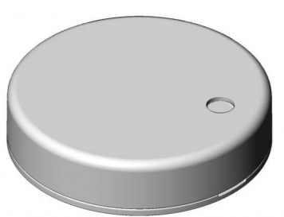
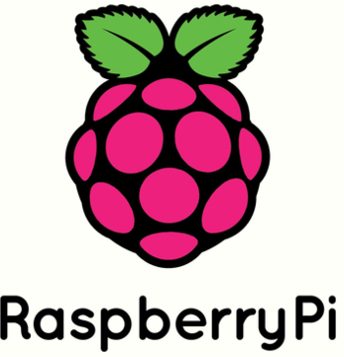


System Architecture and Datapath
Multiple RUUVI sensors
Raspberry Pi Gateway
ICT ConNXT IoT Cloud
Magic Leap One Headset
RuuviTag is a waterproof Bluetooth sensor capable of sending temperature, humidity, pressure and motion information directly to any Bluetooth capable device.
Python scripts running on Raspberry Pi device that periodically receives the data from all RuuviTags and sends them via Internet to ConNXT.
Each RuuviTag has its own portal configured on ConNXT to easily manage and monitor the devices.
Magic Leap Application reads the telemetry data for each RuuviTag from ConNXT, display them to the user in the form of an interactive menu and an animated heatmap.

